Slide 1
Adapted Sensory Programming for All Ages & All Budgets
September 19, 2017
Presented by:
Jen Taggart, Bloomfield Township Public Library
Laura Hollister & Sarah Skinner, Niles District Library
Marta-Kate Jackson, Cromaine District Library

Slide 2
Survey of Michigan Libraries
Sensory story times geared to children, teens, and adults (inclusive and targeted)
Outreach sensory story times to all ages in special education classrooms
Adapted programs for youth, teens, and adults with visual impairments
Weekly and monthly activity groups for adults with developmental disabilities and other special needs.
Sensory-friendly movies, adapted yoga, adapted theater workshops
After-hours and/or before-hours targeted programs for families of all ages with special needs

Slide 3
Sensory Story Times
Adaptative “toolbox”
Visual schedule
Rhythmic/interactive stories and non-fiction picture books
Therapeutic movement (yoga, “crossing-the-midline”)
Multi-sensory experiences
Sign language
Stories available in multiple reading formats
Adaptive seating and/or “designated seating”
Dimmed lighting
Sensory play or craft after
Interactive discussion about theme with teens/adults
Scanned books projected on screen for larger class/crowd
Flannel board accompaniment to read-alouds
Offered at less crowded time
Fidgets

Slide 4
Programming for patrons with visual impairments
Audiobook discussion group
Support group for people with visual impairments
Assistive Technology Talks
Summer Reading Program for youth who are blind or have low vision
Monthly activity program for adults with visual impairments

Slide 5
Activity groups for teens & adults with special needs
Weekly & monthly programs
Sensory-friendly movies
Art projects for all abilities
Game days (bingo, board games &/or video games)
Volunteer projects

Slide 6
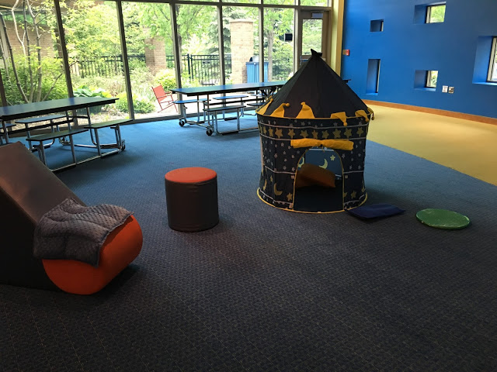
After or Before-hours events
Targeted to families with special needs
Less crowded
Alleviates caregiver anxiety
Sensory activities for all ages
Visual aids throughout library
Calm-down area

Slide 7
Feedback/Learning Experiences
Multi-format marketing (flyers, emails, posters, library cross-promotion, social media) to schools, parent groups, group homes, & local special needs advocacy organizations is key.
Outreach to schools and word-of-mouth
Being cognoscente of a range of developmental ages and abilities.
Collaboration with teachers and/or therapists
Creating a “welcoming environment”
Success is not measured by numbers.
Be open to feedback from caregivers.

Slide 8
Cromaine District Library: Programs for individuals with special needs
Adults
Monthly Storytime for Freedom Work Opportunities
Monthly Cleaning Crew from Freedom Work Opportunities
Teens
Inclusive Teen Volunteer Program
Children
Sensory Storytime for children of all ages and their families

Slide 9
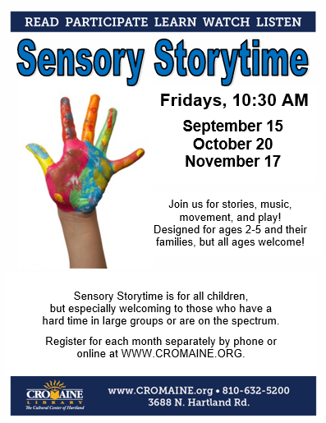
Sensory Storytime
45 minute program
Once a month
Registration limited
to 12 children & their
families or caregivers

Slide 10
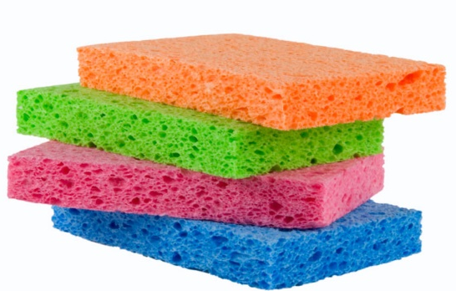
Sensory Storytime
20-25 Minute Storytime
2 stories with additional visuals or interactive element
Flannel, puppets, movement, and/or props
Movement songs with props - shaker eggs, paper cutouts, sponges, etc.

Slide 11
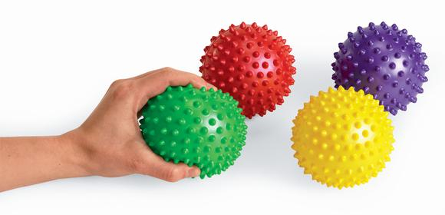
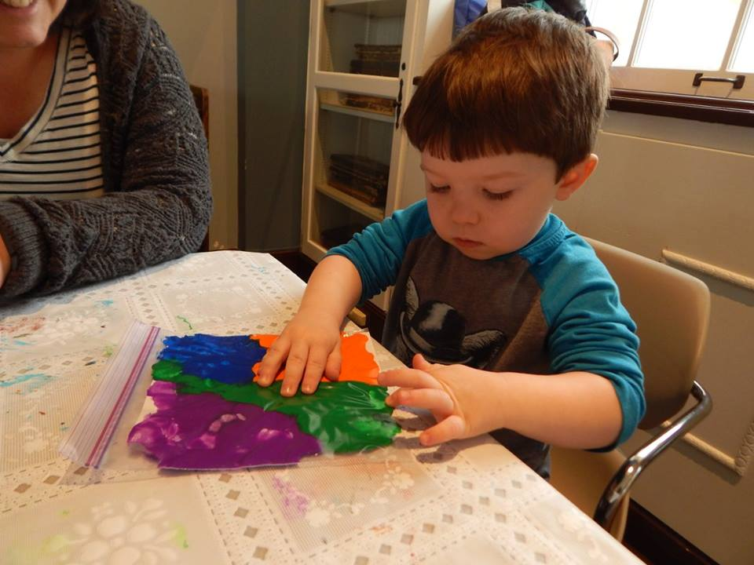
Sensory Storytime
20 Minutes Free Play
Socialization time for kids AND caregivers
Activity stations for exploring at their own pace
Sensory Bin
Puppets or Flannel pieces from storytime
Sensory Balls
Craft or Coloring Station
Early On® teacher present to
answer questions
Ideas for crafts, books, activities and
more resources at
www.theyouthdesk.org.

Slide 12
Local Partners
Program developed based on interests of Early On® teachers from Livingston Educational Services Agency
Teachers wanted an opportunity for their students to interact and observe neurotypical children
Find out what THEIR goal is!
Call local organizations for feedback or invite them to stop by and observe an existing program
www.1800earlyon.org
www.livingstonesa.org
Notes:
Wanted to bring a group of kids to Toddler Storytime.
Had not asked what her goal was assumed it was to simply visit the library.
Invite other organizations to stop by and observe – offered to run it for us.

Slide 13
Early On® Collaboration
Each family often accompanied by their teacher, speech or occupational therapist
Many now hold their caregiver meetings at the library
Teachers & Therapists provided us with tips & advice
Visual Schedule
Slow down lyrics
Sing A Capella
Suggest songs & rhymes

Slide 14
Marketing
Library’s website & online events calendar
Print flyers distributed by Early On® teachers at LESA & other local organizations
Print & email flyers distributed by Hartland Consolidated Schools Department of Special Education
Stop by to chat in-person about distributing info – It worked better for us than by phone or email.
Word of mouth

Slide 15
Marketing
Changed program description to bring in a broader audience
Original Description
Join us for stories, songs, and fingerplays. For children who have a hard time in large groups, with joint attention, or who are sensitive to sensory overload.
Revised Description
Join us for stories, songs, and play! For all children, but especially welcoming to those who have a hard time in large groups or are on the spectrum.

Slide 16
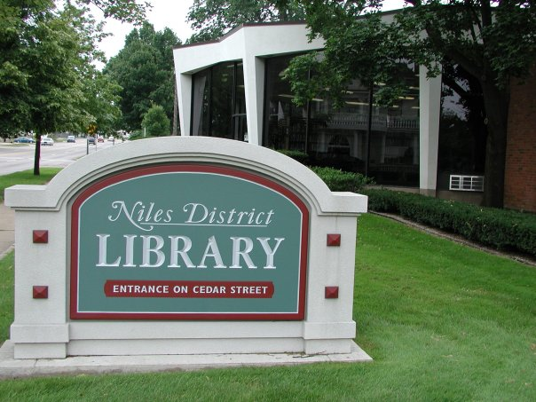
Laura Hollister and Sarah Skinner Niles District Library Adult Services Team Members
Special Edition
Notes:
Hello! I’m Laura Hollister, adult services team leader at Niles District library, and the proud mom of 6 sons. Three of them struggle with disabilities, and two are significantly affected.

Slide 17
Special Edition
Why do we need it?
Who does it serve?
How can we make it happen?
Notes:
Do you already have groups of special needs folks coming in to your library? Maybe individuals with a worker?
Do they just sit at a table, bored, because they just don’t fit in anywhere?
You can help. Most of them would be interested in storytime or tween groups. You’re already developing and providing this content. Just commit to re-serving it to a broader group!

Slide 18
Why?
Special Edition
And why at a library?
Notes:
Why?
Your community is full of adults who have social and educational goals, with very few places to work on them.
Many families, like mine, have both affected and neurotypical children. We need a place to enjoy activities together.
Why at a library?
Libraries are the perfect collaborator. We can connect resource providers with consumers in a safe and open environment.
Libraries need to serve everyone to remain the vibrant centers of our community we know they are (or can be).

Slide 19
What can we do?
Special Edition
Offer high quality, high interest events.
Keep the schedule predictable and accessible.
Embed multiple opportunities in every program.
Notes:
We can offer high quality, high interest events to draw non-affected families too.
Make everything a learning opportunity on multiple levels:
-Read and Return Books: Practicing responsibility without penalty.
-Movie Days: Practicing appropriate social behavior, decision making, (and possibly even money skills at a concession stand).
Incorporate sensory and motor skills on craft day
Discuss the importance of maintaining physical health and wellness on Zumba days

Slide 20
Where do I find partners?
Special Edition
Community mental health gateway organizations
Community Living Support (CLS) providers
Residential and in-home support providers
Notes:
All Michigan communities have a mental health gateway organization. Find them and ask to meet with a caseworker or representative to determine what is already available in your community, and what service holes you can fill.
Also look for local Community Living Support (CLS) providers. They are already working with individuals or small group participants and are always looking for opportunities for enrichment. Ask them to help you offer these opportunities.

Slide 21
AS and YS together
Special Edition
Youth Services is already doing great things. Shamelessly copy or repeat them!
Notes:
The recipients are adults, but their interest level is often in line with what YS is already doing. Replicate, replicate, replicate! Created a great program for middle schoolers? Repeat it for the special needs adults! Prepared a storytime for the early elementary ages? Repeat it for the adults! Love your toddler dance party? Pull out the CD player and the handheld instruments- Beatles, Monkees, What Does the Fox Say- anything that gets you moving! Have extra crafts from storytime? Make them into individual “kits” and when you have enough, set out the craft smorgasboard so they can choose the one that appeals to them!

Slide 22
Tap your community for program content.
Don’t re-create the wheel! Find what amazing things are already happening in your area:
YMCA adaptive Zumba dance
Impersonators/cosplay (Disney, Star Wars, etc.)
Lego/WeDo simple machines
Zoo visits
4-H animal clubs
Healthy eating projects from hospital educators
Therapy dogs
Recently released movies
Crafts: art clubs, CLS providers, homeschoolers

Slide 23
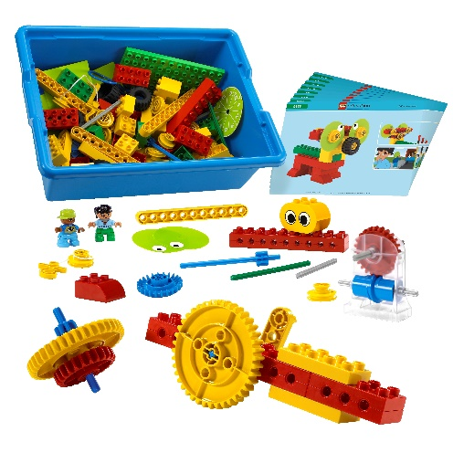
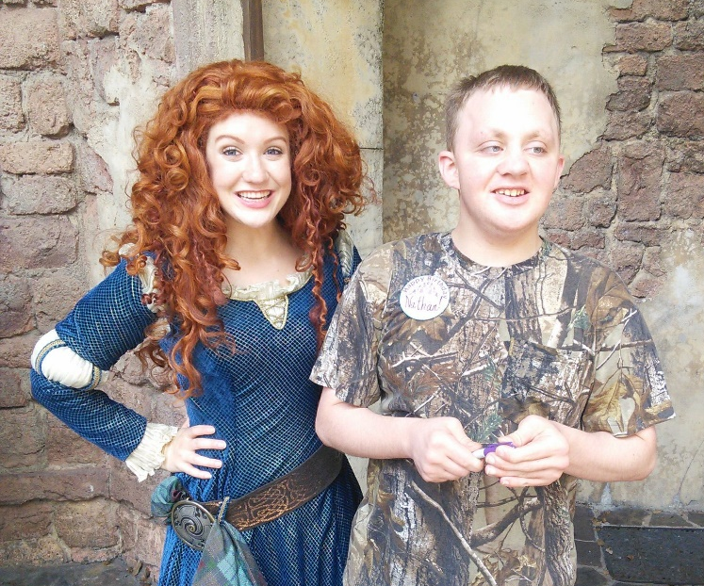
Michiana Youth Robotics
Notes:
YMCA adaptive Zumba dance
Impersonators/cosplay (Disney, Star Wars, etc.)
Lego/WeDo simple machines
Zoo visits
4-H animal clubs
Healthy eating projects from hospital educators
Therapy dogs
Recently released movies
Crafts: art clubs, CLS providers, homeschoolers

Slide 24
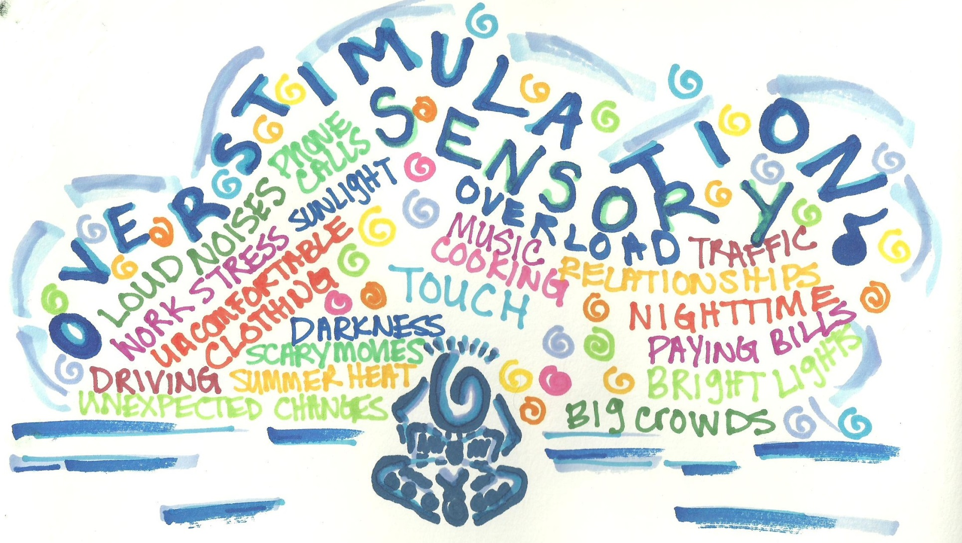

Slide 25
Be Sensitive to Sensory Issues
Make the space as inviting as possible:
Allow space to pace
Try for friendly lighting
Provide visually quiet retreats
Keep volumes at a conversational level
Consider an SI consult to identify potential problems and solutions.
Notes:
Sitting still can be hard!
Harsh lighting can trigger behaviors. Tone it down whenever possible. Aim for the feel you’d like in your living room, rather than your office.
Lots of movement and activity can be hard to take when you don’t have filters that work well. A corner away from the activity or even retreating into the stacks can help provide equilibrium.
Sometimes things get loud. Have a few sets of cheap noise cancelling headphones behind the desk for those who are headed towards overstimmed.
Ask your school district or local healthcare provider if they have an Occupational Therapist that would help you understand and address any Sensory Integration issues.

Slide 26
Promote! Promote! Promote!
Make your handouts visually engaging, catering to a pre-literate participant.
Notes:
Publicity is your greatest ally when getting programs off the ground.
Make colorful graphics (flyers, handouts, etc.) that cover 4-6 weeks of programming. Less is difficult to keep current in all locations. Longer allows them to go stale or be forgotten.
Once you’ve made them, what do you do with them?
Distribute to local residential facilities.
Ask community mental health gatekeepers to distribute flyers that you have provided during home visits.
Promote through ISD programs.
Social media platforms
The language used can be highly sensitive, especially for those not used to travelling in these circles. Be sensitive to appropriate terminology, but don’t allow it to paralyze you. As a mom, I can tell the difference between when you’re being insulting and when you’re simply not aware of the currently popular (but ever changing) socially appropriate terminology. I’ll correct you if needed, but I’m mostly going to be happy you care enough to provide services for my sons and my family. Once you have people regularly attending, ask them what they prefer. Our marketing uses the term “special needs adults” because that’s how my group chose to self-identify. Again, it’s about providing choice and respecting it.

Slide 31
Remember:
You really can make a difference.
Find the providers and you’ve found your partners.

Slide 32
What’s next?
Notes:
I would like to reach out to area civic organizations asking them to each adopt a month. They could locate and contract with a performer, etc for one of the weekly gatherings. This will help broaden awareness and contacts. What ideas do you have?

Slide 33
Follow-up
Jen Taggart, Bloomfield Township Public Library taggartj@btpl.org http://adaptiveumbrella.blogspot.com/ Twitter: @librarianjennt
Marta-Kate Jackson, Cromaine District Library mjackson@cromaine.org
Laura Hollister & Sarah Skinner, Niles District Library laura.hollister@nileslibrary.net sarah.skinner@nileslibrary.net

