Slide 1
& Storytimes
Marta-Kate Jackson – Youth Services Librarian
Hartland’s Cromaine Library
Notes:
Today I will be sharing ways to enhance story, circle times and play with activities that will engage more of your students’ senses. Sensory play maximizes learning as children learn best when all of their senses are engaged.

Slide 2
Overview
What is Sensory Play?
What is Sensory Storytime?
What can you do?
How to select books
Favorite Songs & Rhymes
Favorite Play Activities & Crafts
Your Experiences
Let’s Play!
Notes:
Brief overview of sensory play, what it’s all about, and why the library is incorporating it into our programs for children.
Overview of our monthly Sensory Storytime, a program created to bring books to life through sensory play and not only fun for neurotypical children, but perfect for children with special needs too. The content for this program and all the ideas I’ll be sharing are designed for ages 2-5 but you’ll find the activities are very adaptable and engaging for babies and older children too!
Share with you the books, songs, rhymes & play activities we’ve used which you can use with your own kids and give you some tips for finding your own.
I’m assuming some of you are already incorporating fabulous ideas into your own programs, so I would like to take some time near the end to hear about what activities you have found successful.
Opportunity to have some sensory playtime too!

Slide 3
Sensory Play
Sight
Sound
Smell
Proprioceptive
(body position)
Touch
Vestibular
(balance & movement)
Taste
Notes:
Sensory play is simply play that encourages children to use one or more of the senses, such as sight, sound, smell, touch, taste, and a couple lesser known senses called proprioceptive sense (sense of body position – knowing where your body parts are without looking at them) and vestibular (sense of balance and movement – spinning, swinging, rocking in a chair) Mastering all 7 allows children to learn about their world and function effectively. (Cross p. 16).
Sensory activities are not just a fun way to build essential skills, but can be calming for some children too. They offer great learning opportunities for children on the Autism Spectrum or Sensory processing disorders, but as you’ll see any child will have fun with sensory play, because at the end of the day it’s just play!

Slide 4
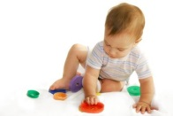
Benefits of Sensory Play
Cognitive Development
Social Skills
Sense of Self
Fine & Gross Motor
Emotional Development
Communication Skills
Language Development
Notes:
Cognitive development - even before children can speak they’re developing an understanding of their environment; Play helps them work through things, solve problems, and figure out elements in the world around them work and are connected
Social skills – If they’re working closely together they’re learning to share space and materials AND observing how others handle materials and solve problems
Sense of self - children discover their own preferences; maybe they like dry sand but not slimy things.
Physical skills - develop & strengthen motor skills. For example, different muscles are used the scoop than holding a cup or spoon.
Emotional development - Sensory play can be emotionally calming for some children - pressure of play dough or simply joy of the activity can provide them with emotional security
Communication skills – See how others react, see how you react gives them cues for what they’re doing.
Language Development – Solid grasp of language makes learning to read later on SO much easier. You can encourage that by asking engaging questions with rich vocabulary while the children. Descriptive and action words such as cold, hot, bumpy, shiny, smooth, pour, dump, scoop, sift, and splash will help solidify the meanings of these words in a young child’s mind. If a child has never heard a word before, it’s going to be much more difficult to try to sound it out later on.

Slide 5
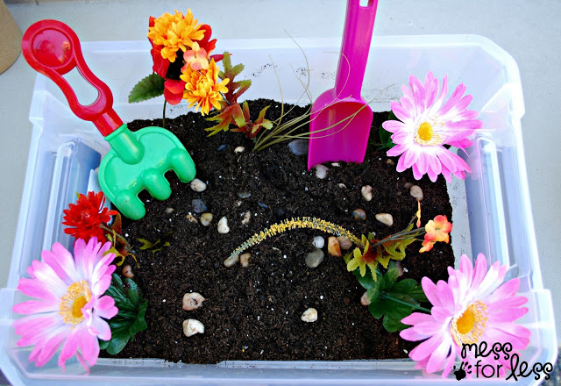
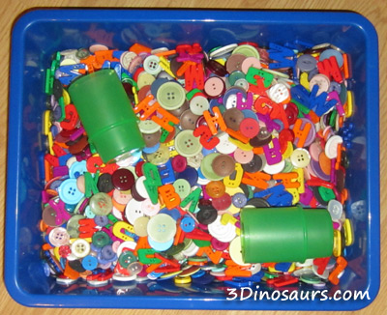
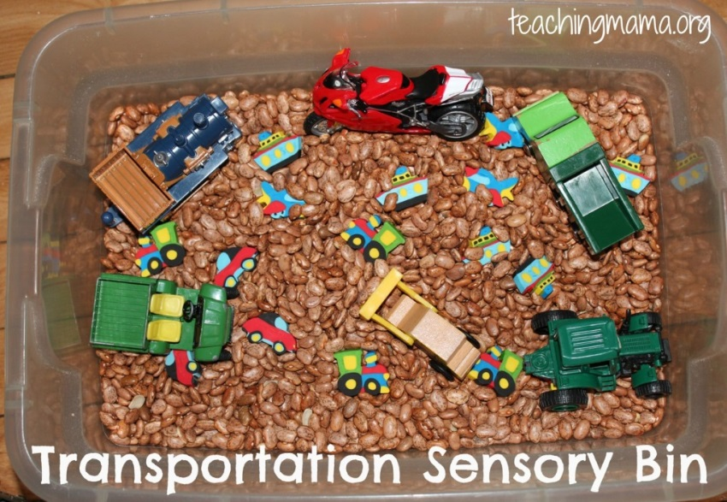
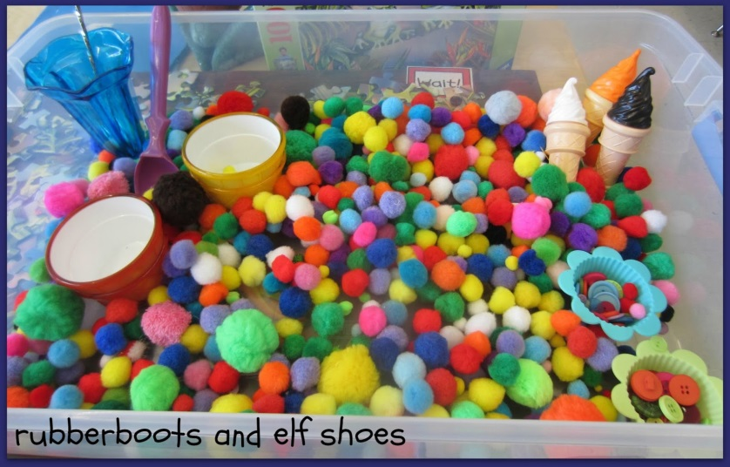
Sensory Bins
Notes:
One of the most common forms of Sensory Play you may be familiar with is through Sensory Bins. They are excellent ways to naturally encourage kids to explore, create, investigate, and play.
You fill a bin with something your child can shovel, rake or pour, such as dried beans, rice, pasta, shredded paper, etc.
Add tools they can use to manipulate the fill, such as tongs, ladles, spoons, measuring cups, sandbox toys, funnels, to develop small motor skills.
Add topical items that might relate to a theme your are teaching or a book you’ve just read, such as toy trucks, etc.
Images from http://www.messforless.net/garden-sensory-bin/
http://www.rubberbootsandelfshoes.com/2013/07/ice-cream-book-and-sensory-bin.html
http://teachingmama.org/transportation-sensory-bin-activities/
http://www.3dinosaurs.com/wordpress/index.php/button-sensory-bin/

Slide 6
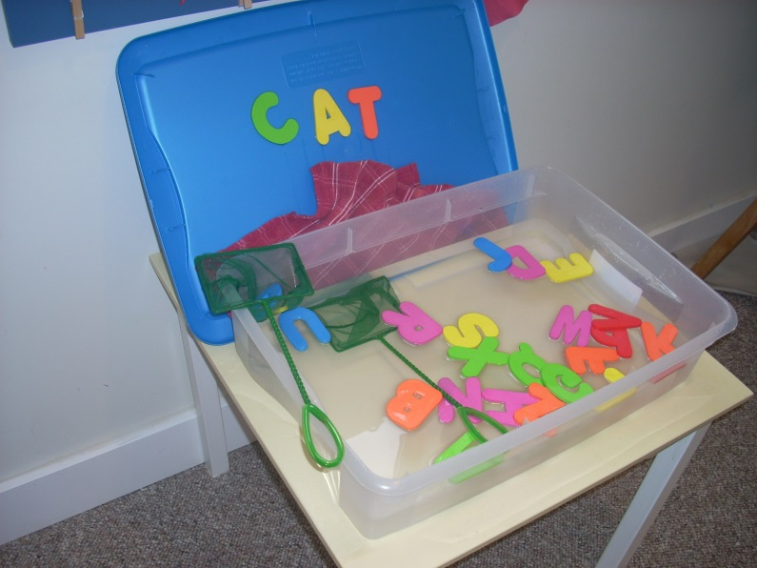
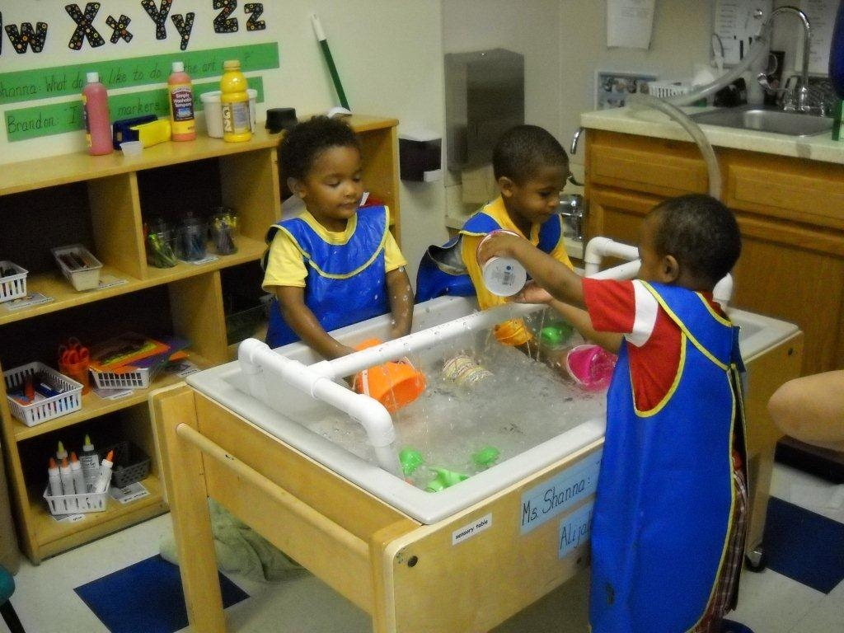
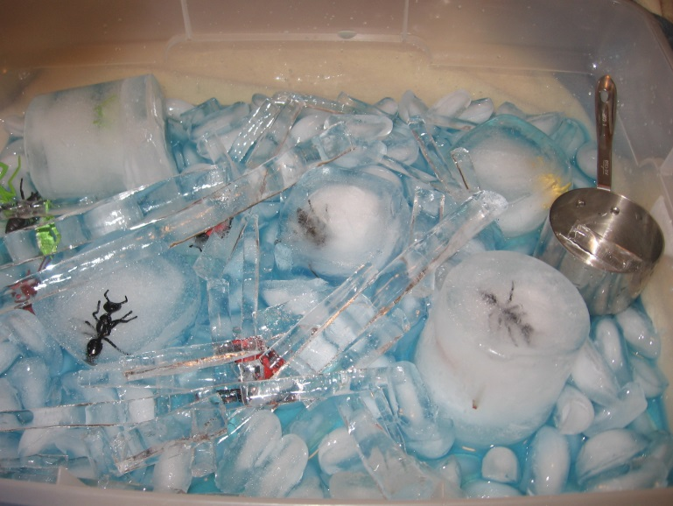
Water Tables
Notes:
Like the bins, you fill tubs or bins with water, ice cubes, some tools and have fun!
I like to add food coloring and scents like lemon or scented oils and ice with toys frozen inside.
https://www.earlylearningin.org/2010/09/24/friday-faces-day-nursery-northwest-center-preschoolers/
http://notjustcute.com/2008/12/08/the-sensory-table-on-a-budget/

Slide 7
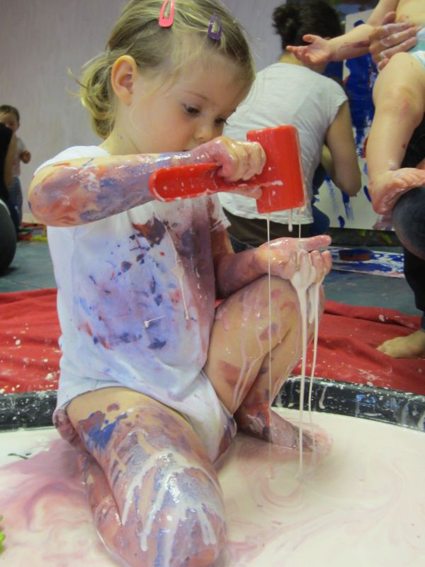
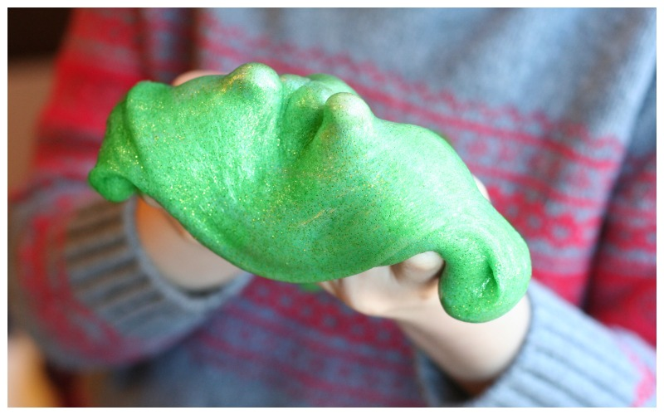
Slimy Fun
Notes:
I have had a lot of success with playdough and slimes. Adding scents to these is encouraged too, such as cinnamon, pumpkin spice, lemon, kool-aid packets, etc. Mix glitter and objects into them.
These are common examples and it’s easy to see how sight and touch are being engaged, but movement, sound, and smell are powerful components of play too and later I will show you additional activities we’ve used to incorporate them AND how we use play to bring books and literacy to life.
http://messy-monkeys.ie/me
http://lemonlimeadventures.com/calming-glitter-slime/ssy-play/

Slide 8
Why Sensory Play at the Library?
Notes:
Before I give you more examples, you may be wondering why the library is interested in sensory play. In addition to all the benefits mentioned previously, one reason is because we’re not your mamas’ libraries any more! Instead of this we’re much more like…

Slide 9
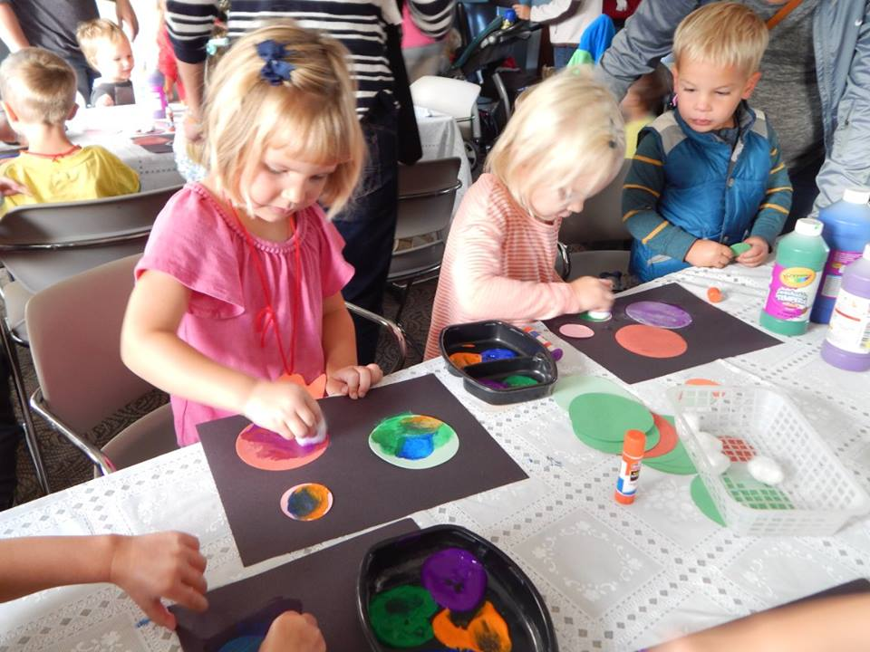
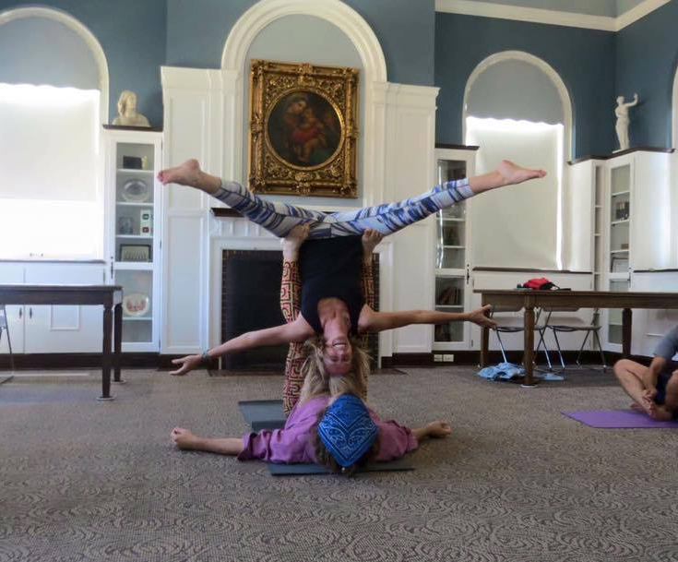
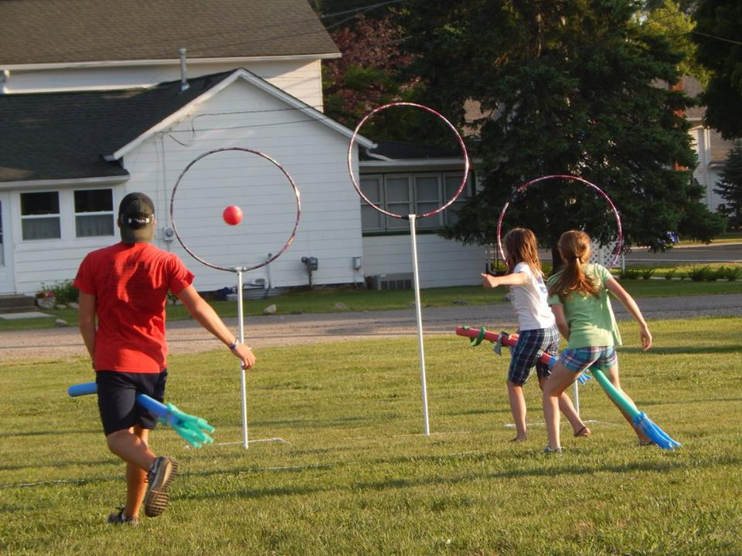
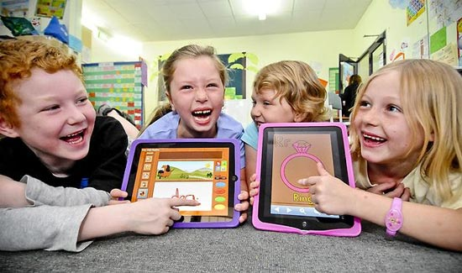
Why Sensory Play at the Library?
Notes:
This! We offer crafts, science programs, art classes, Quidditch all to help children explore their world and put what they’re reading about into action. For 5 and unders our focus is on encouraging them to develop early literacy skills and help caregivers understand how they can help their children/students too. Early Literacy is a cornerstone of youth services in libraries.

Slide 10
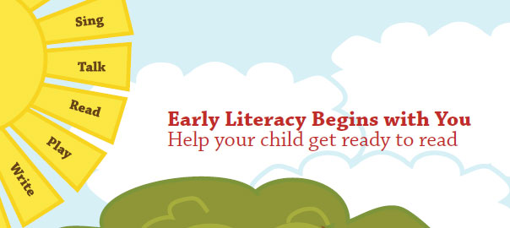
5 Practices of Early Literacy
Singing
Talking
Reading
Writing
Playing
Notes:
Early literacy is what children know about reading and writing BEFORE they learn to read and write…how to hold a book, what way the pages turn, that the scribbles they see are individual letters even if they’re not sure what all the letters are, do they hear a rhythm to words or words sounds, can they tell stories…All these things are accomplished by these 5 practices. By talking, singing, reading, writing, and playing children are able to develop the skills necessary to be better prepared to learn to read once they enter school. So exploring sensory play is another way for libraries to accomplish this.

Slide 11
Offer more Inclusive Programming
According to the US Center for Disease Control, 1 in 6 U.S. children have a developmental disability or delay.
Remove barriers for enjoying the library.
Give kids more options for experiencing stories and play.
Notes:
According to the US Center for Disease Control, 1 in 6 U.S. children have a developmental disability or delay. So whether you, their parents or caregivers know it, if you have more than 6 kids in a classroom (according to this statistic) there’s a good chance at least one of them may be struggling with something.
Remove barriers for enjoying the library – We’ve added more music, play, and interactivity to our traditional storytimes and programs over the years, but wanted to offer something specifically for those children that might not be comfortable in them. We discovered there are some families not utilizing the library because either their children are not comfortable there or their caregivers are not comfortable there.

Slide 12
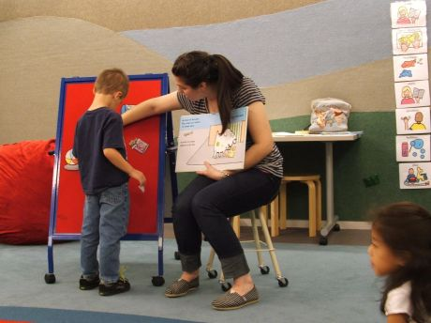
Sensory Storytime
Use sensory play to bring literacy and books to life
20-25 minutes of storytime followed by 25 minutes exploratory playtime
Storytime: Make stories, songs, and rhymes interactive through movement, props, and play
Playtime: Sensory crafts, bins, coloring, felt board, puppets
Developmentally appropriate for ages 2-5, but all are welcome!
Notes:
Image from http://www.triblocal.com/skokie/calendar/2012/02/18/sensory-storytime/

Slide 13
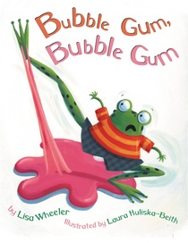
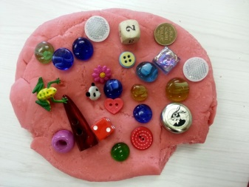
Bubble Gum, Bubble Gum By Lisa Wheeler
While reading: Place images of the characters on a board when each one gets stuck in the bubble gum OR have pass out images of the characters and have kids bring them up when appropriate.
Afterwards: If you’re a toad and you know it hop around!...
Sensory Extension Activity: Bubble Gum Playdough – Press it, roll it, cookie cut it, etc.

Slide 14
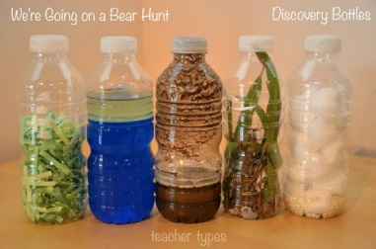
We’re Going on a Bear Hunt By Michael Rosen
While reading: Encourage kids to move along with the story. Place images of each stage of the story on a board as you read.
Afterwards: Pass out snowflake cutouts and swirl them around to a song or rhyme, such as:
Snowflake, snowflake falling down
Snowflake, snowflake touch the ground
Snowflake, snowflake on the wind
Snowflake, snowflake spin and spin!
Sensory Extension Activity: Sensory Bottles

Slide 15
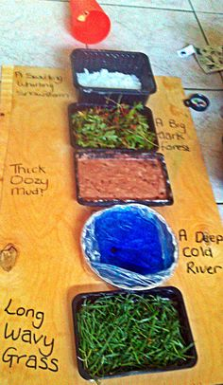
We’re Going on a Bear Hunt By Michael Rosen

Slide 16
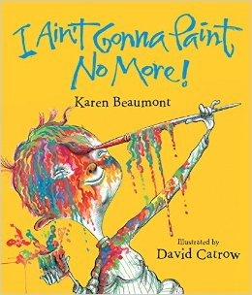
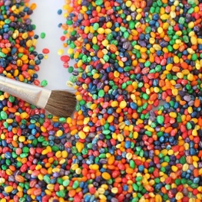
I Ain’t Gonna Paint No More By Karen Beaumont
While reading: Provide kids with dry paint brushes to “paint” their parts along with the story.
Afterwards: Sing a song that identifies body parts – Head, Shoulders, Knees Toes
Sensory Extension Activity: Provide a dry paintbrush to draw/write through a colored rice, barley, or shaving cream.

Slide 17
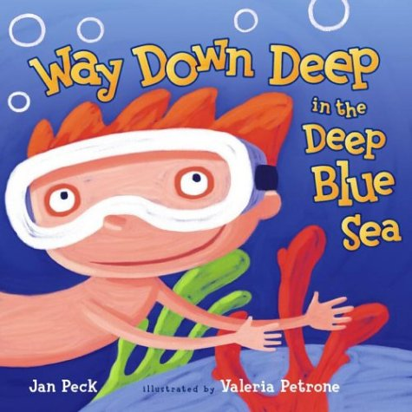
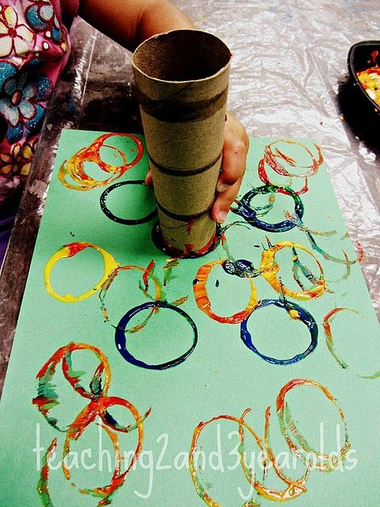
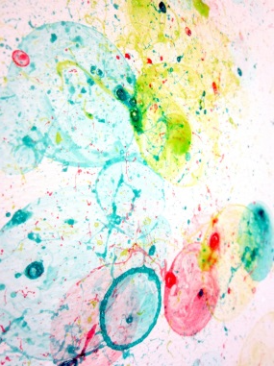
Way Down Deep in the Deep Blue Sea By Jan Peck
While reading: Encourage kids to “swim” each time the phrase “swim away” is repeated or give them a felt/paper fishy to swim each time they hear the phrase. Place sea creatures on a board and take them away when appropriate.
Afterwards: Pass out fish/shark/whale cutouts and sing “The fish in the sea go swish, swish, swish..”
Sensory Extension Activity: Bubble Prints – Stamp a paper roll into bubble soap mixed with paint and then onto white cardstock
Notes:
http://vividlayers.blogspot.com/2011/12/bubble-prints.html

Slide 18
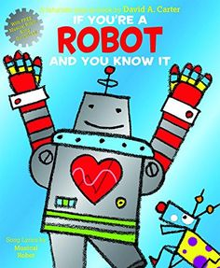
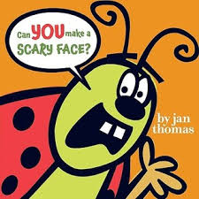
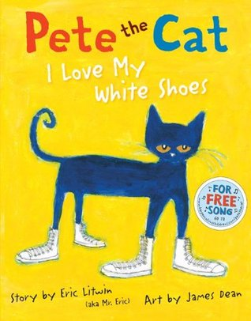
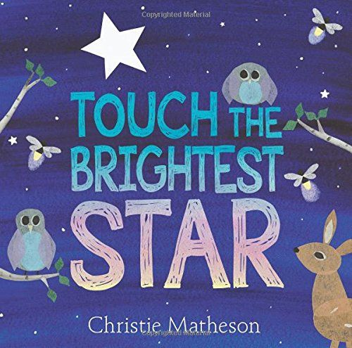
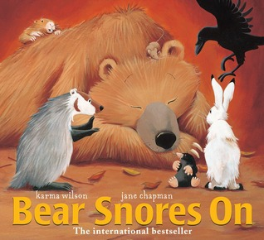
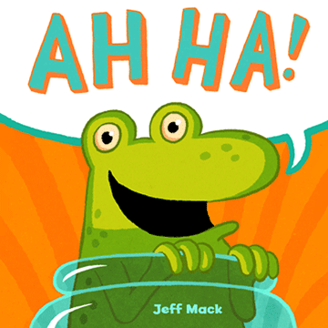
Choosing Books
High interest themes
Repetition
Large uncluttered illustrations
How can you make it interactive?
Do you enjoy reading it?
Notes:
High interest themes - Choose themes any child can relate to regardless of their special need, such as taking a bath, bedtime, food, animals, colors, transportation, etc.
Repetition - predictable, repetitive lines help children become more comfortable with listening to a story and HUGE help in brain development as repetition helps synapses firing. Plus, not only does repetition bring stories to life, it will help entertain your audience too!
Large uncluttered illustrations - show Dog’s Colorful Day - stories are told through the pictures so make sure they are large enough to be understood, visual cues to understand whats happening
Every book should be interactive
Flaps, flannel pieces for kids to help tell the story, song that goes along with it, movements to go along like clapping or shakers - helps them get their wiggles out and make abstract more concrete

Slide 19
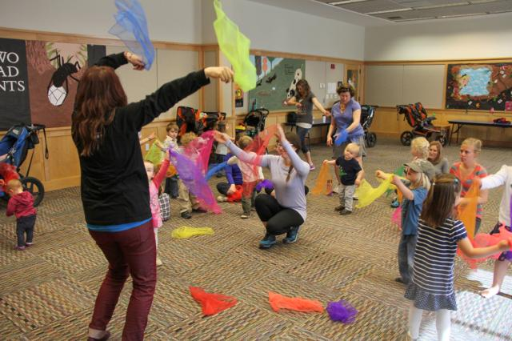
Music & Movement
Move at varying speeds
Use props!
Scarves, bean bags, ribbons, bells, instruments, puppets, paper cutouts, sponges, paintbrushes, etc.
Move to the beat
Use props to tap or gently touch body parts
Acoustic music
Notes:
Move at varying speeds – march around the room try super slow, super fast, medium slow, etc.
Use Props! – Scarves, bean bags, bells, ribbons. If we are doing a song I almost always try to provide them with a prop.
Acoustic Music – Most songs are too fast to pair movement with unless the kids are extremely familiar with the song AND it can be overwhelming for kids that are too sensitive to sounds.
Image from http://www.alsc.ala.org/blog/2015/02/music-movement-stories/

Slide 20
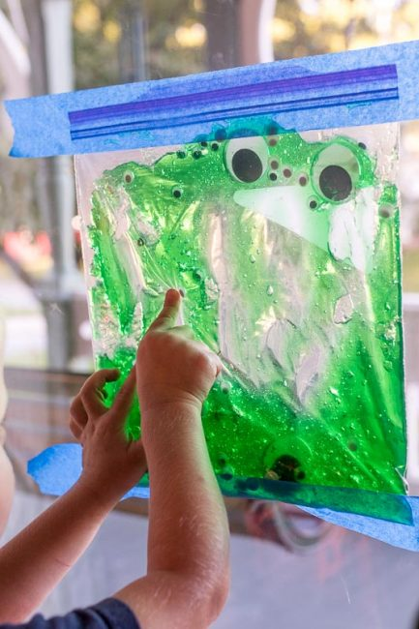
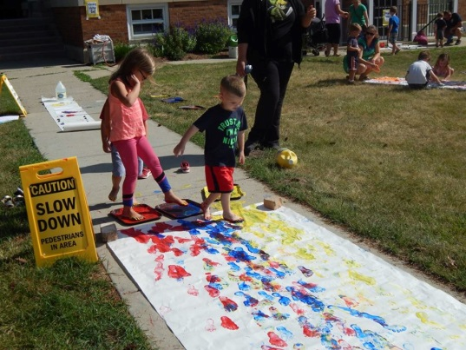
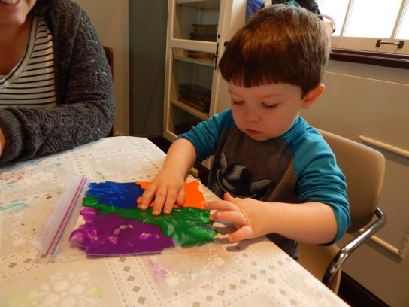
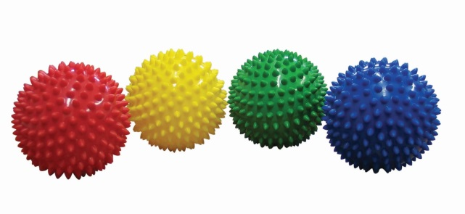
Sensory Play
Ask Engaging Questions
What other things are round like a ball?
What if you woke up tomorrow and could fly like this bird? Where is the first place you would fly?
What if the room was filled to the ceiling with _____? Show me how you would move! How would it feel to be covered in ____? Would you eat any?
Offer more play options
Coloring sheets with story characters
Materials in bottles or plastic bags
Notes:
Window bag image from http://handsonaswegrow.com/edible-slimy-eyes-sensory-bag-toddlers/
Sensory balls available from Lakeshore Learning, but we found ours at the Dollar Tree

Slide 21
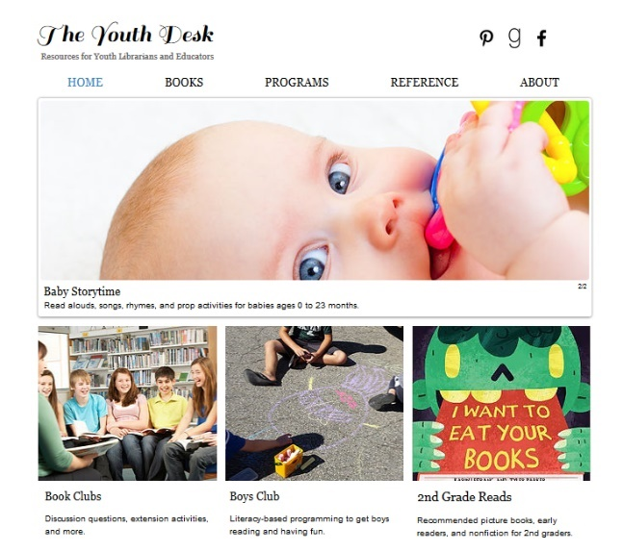
Thank YOU, Let’s Play!
Marta-Kate Jackson
Youth Services Librarian
Hartland’s Cromaine Library
mjackson@cromaine.org
www.theyouthdesk.org

